Slide 1
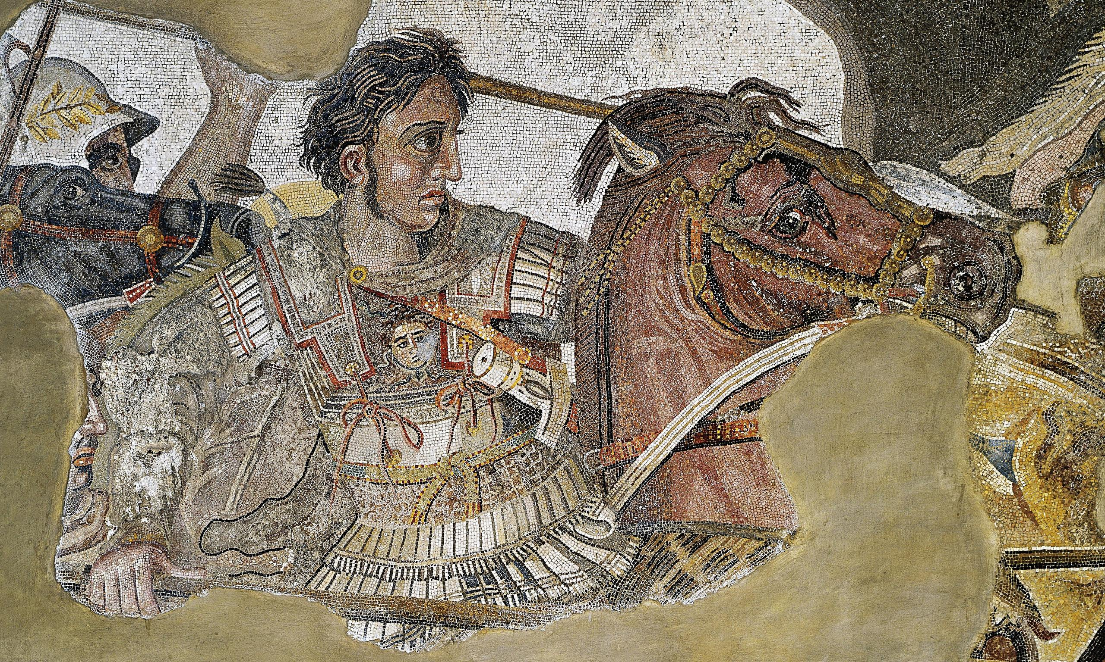
Alexander the Great Review
Goal/s:
Review Alexander the great
Week 1 Lesson 1 – unit 2
Ms Barrie

Slide 2
Term 3 - 4 Overview
Week | Topic/s | Assessment
1 - 2 | Review of Alexander the Great
3 | Source Analysis Skills | WEEK 3: TASK 5 – Source Analysis
4 | ATG – Continuity and Change ATG – Legacy and Impacts
5 - 6 | Ancient Rome Overview
7 - 10 | Julius Caesar (JC) | WEEK 8: TASK 6 – Test WEEK 10: TASK 7 – Explanation (Essay)
1 – 4 (Term 4) | Historical Inquiry Project Selected Individual | WEEK 1 - 4: TASK 8 – Historical Inquiry Project/Validation

Slide 3
What do you already know about Alexander the Great?
Class discussion

Slide 4
ACTIVITY - Poster
Create an A3 Poster about the life of Alexander the Great
Due at the end of the Lesson
These will be displayed!

